Slide 1


ESG REPORT ANALYSIS USING NLP
Mentor - Prof. Darshan Solanki
Team ID: CSESGP2378
Created by JJ

Slide 2


CONTENT
01
02
03
04
Our
Team
Problem Statement
What is
ESG?
Why analyze ESG Reporting using NLP?
05
06
07
08
Literature Review
Methodology
Case Studies
Conclusion

Slide 3



OUR TEAM
Rikin Zala
IU2041230201
zalarikin.20.cs@iite.indusuni.ac.in
👉 Linkedin
Jaynil Zala
IU2041230200
zalajaynil.20.cs@iite.indusuni.ac.in
👉 Linkedin
Harsh Thakkar
IU2041230183
thakkarharsh.20.cs@iite.indusuni.ac.in
👉 Linkedin

Slide 4


PROBLEM STATEMENT
The world is facing a growing number of complex challenges, including climate change, social inequality, and political instability.
As a result, investors are increasingly looking to environmental, social, and governance (ESG) factors when making investment decisions.
However, analyzing ESG reports can be a time-consuming and complex process, requiring a deep understanding of the issues at hand.

Slide 5

This is where natural language processing (NLP) comes in.
By using NLP to analyze ESG reports, investors can quickly and accurately identify key issues and trends, allowing them to make more informed investment decisions.
There are still challenges to be overcome in this field, including the need for more accurate and reliable data, as well as the need for more sophisticated algorithms to analyze that data.

Slide 6

WHAT IS ESG?
ESG stands for Environmental, Social, and Governance.
It is a set of criteria that investors use to evaluate companies on non-financial factors that may have an impact on their financial performance in the long run.
Environmental - Air and water consumption, Energy efficiency, Renewable energy
Social - Community relations, Employee engagement, Customer relationships
Governance - Board composition, Shareholder rights, Company leadership

Slide 7
WHAT IS ESG?
ESG has become an important consideration for investors because it helps them identify risks and opportunities that may not be reflected in traditional financial analysis.
For example,
A company with poor environmental practices may face regulatory fines or reputational damage, which could affect its bottom line.
Similarly, a company with strong social policies may attract and retain top talent, leading to better performance over time.

Slide 8



WHY ANALYZE ESG
REPORTS USING NLP?
Using NLP to analyze ESG reports can provide investors with valuable insights into a company's environmental, social, and governance practices.
By analyzing the language used in these reports, NLP algorithms can identify key themes and trends that may not be immediately apparent to human analysts.

Slide 9
WHY ANALYZE ESG
REPORTS USING NLP?
For example, NLP can help identify companies that are making significant progress towards achieving their sustainability goals, as well as those that may be falling short.
It can also help identify emerging risks and opportunities that may not be reflected in traditional financial metrics.
By incorporating this information into their investment decisions, investors can make more informed and socially responsible choices.

Slide 10


LITERATURE REVIEW
The literature on ESG analysis using NLP is vast and growing.
Researchers have explored various aspects of the topic, including sentiment analysis, topic modeling, and entity recognition.
One study found that using NLP to analyze ESG reports can help investors identify companies with better environmental, social, and governance practices.

Slide 11
LITERATURE REVIEW
Another study focused on the use of NLP to analyze news articles related to ESG issues.
The researchers found that NLP can help investors stay informed about emerging ESG trends and potential risks.
Overall, the literature suggests that NLP can be a valuable tool for ESG analysis, helping investors make more informed decisions and promoting sustainable business practices.

Slide 12






METHODOLOGY
Data Processing
Quality Scoring
Data representation
Data
Gathering
Quality Management
ESG Performance

Slide 13
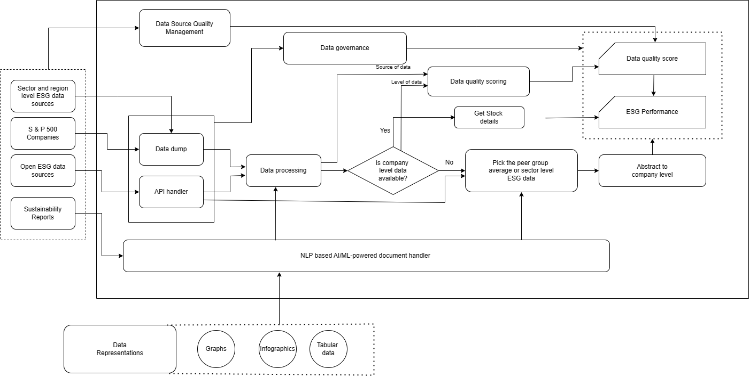
DATA FLOW DIAGRAM

Slide 14

NLP APPROACH - HOW IT WORKS?
Step - 1
Step - 2
Step - 3
Get the sustainability report
as a
pdf
Use pdf parser to collect textual data from
pdf
Clean the text through,
to remove unwanted characters from pdf

Slide 15

NLP APPROACH - HOW IT WORKS?
Step - 4
Step - 5
Step - 6
Retrieve the data with keywords based on sentiments Score
Apply ESG-BERT transformer model (NLP model) to text data
Categorize
and
classify them
to get
final Score

Slide 16
TOOLS & TECHNOLOGIES
Frontend:
HTML
CSS
JavaScript
React
Backend:
Python
Flask
Java (TIKA)

Slide 17

SCREENSHOTS
OF
WEBSITE

Slide 18
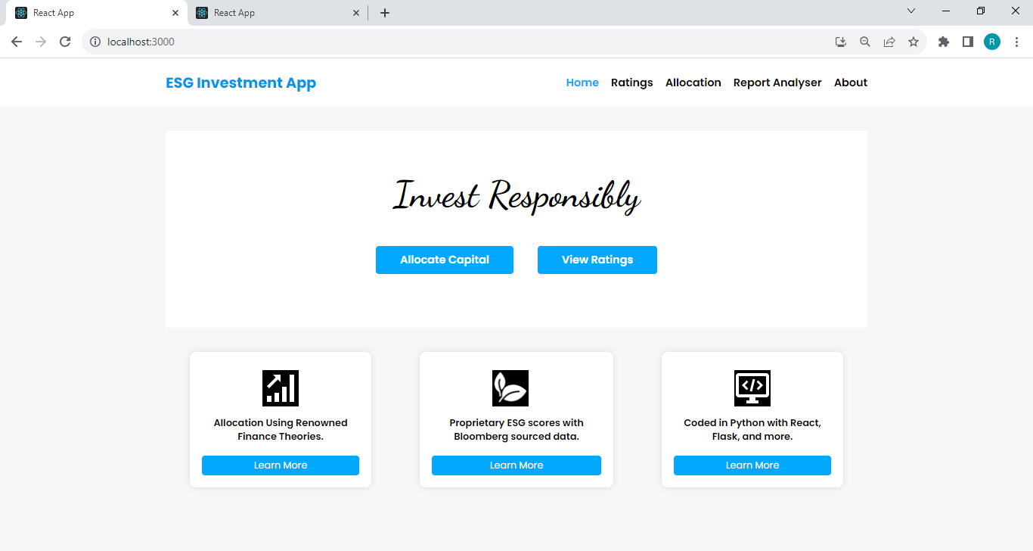
1
Home Page

Slide 19
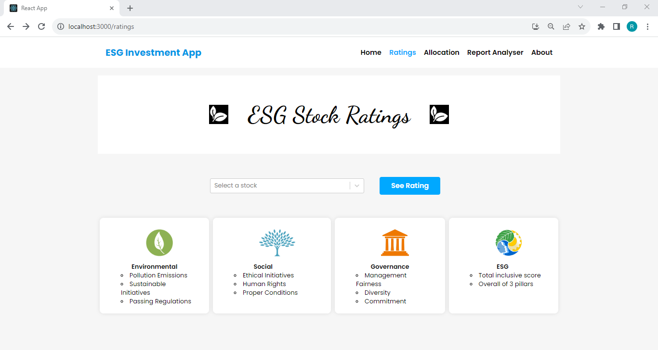
2
Rating Page

Slide 20
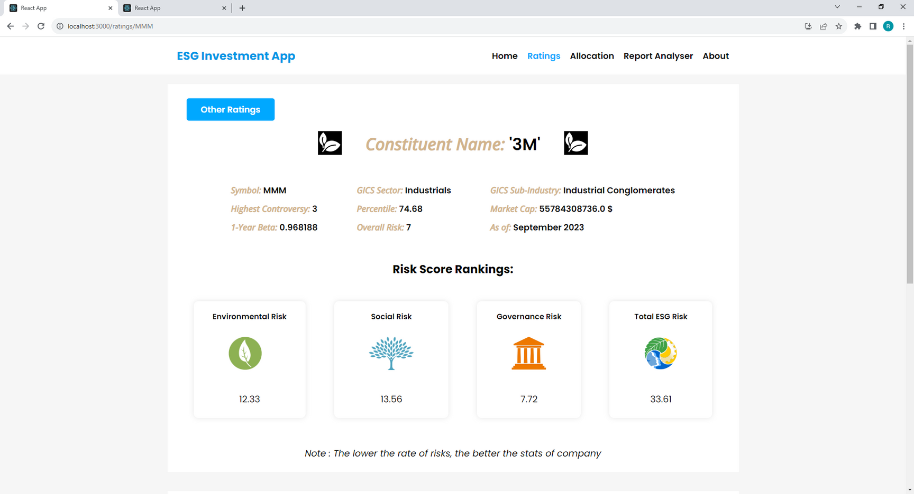
3
S&P 500 Constituents

Slide 21
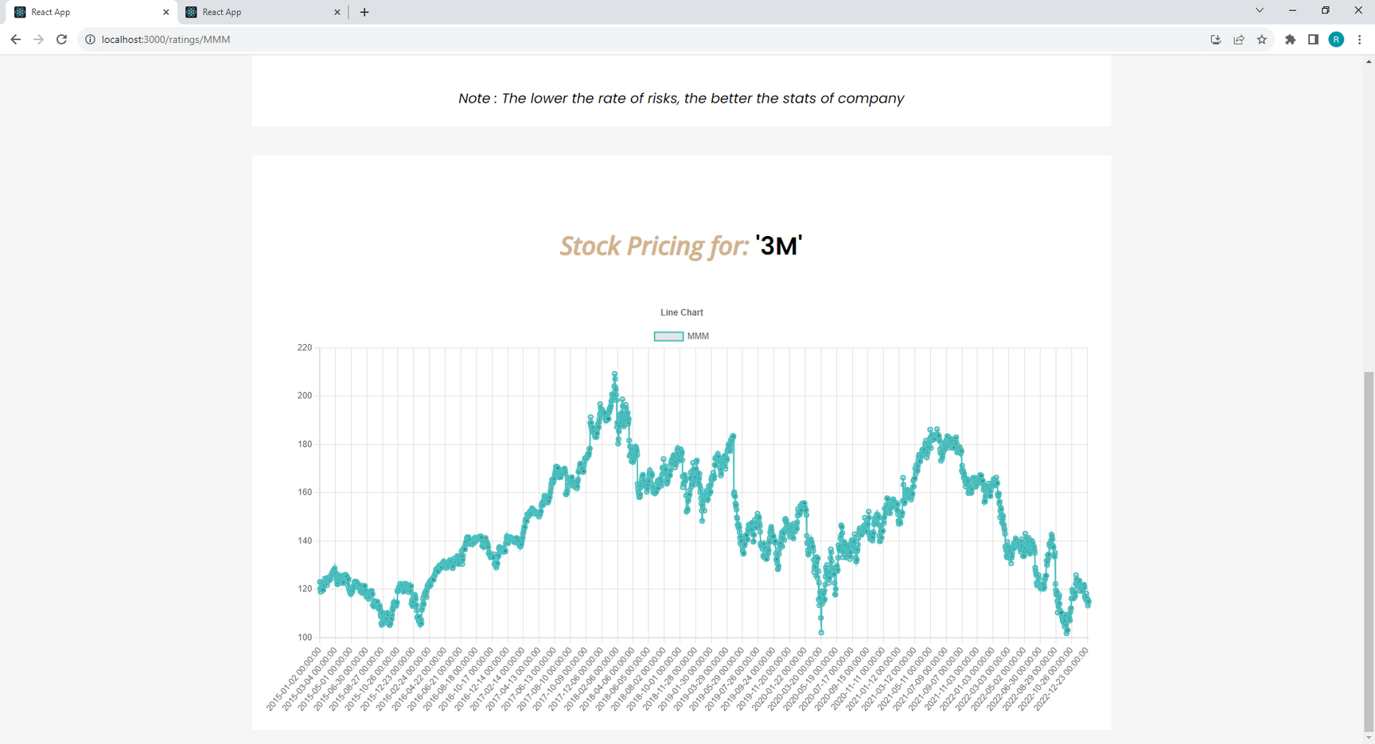
4
Stock pricing from 2015

Slide 22
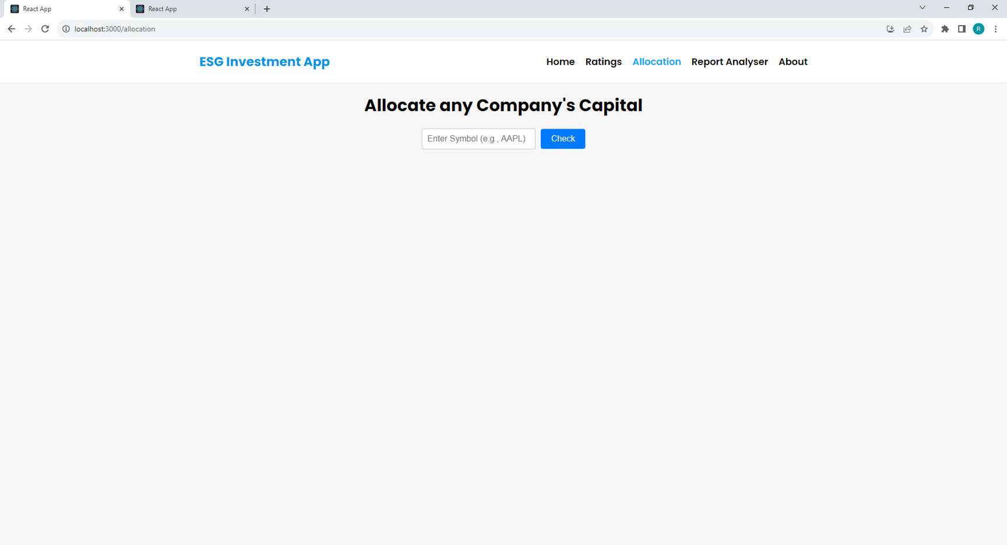
5
Allocation of company’s capital

Slide 23
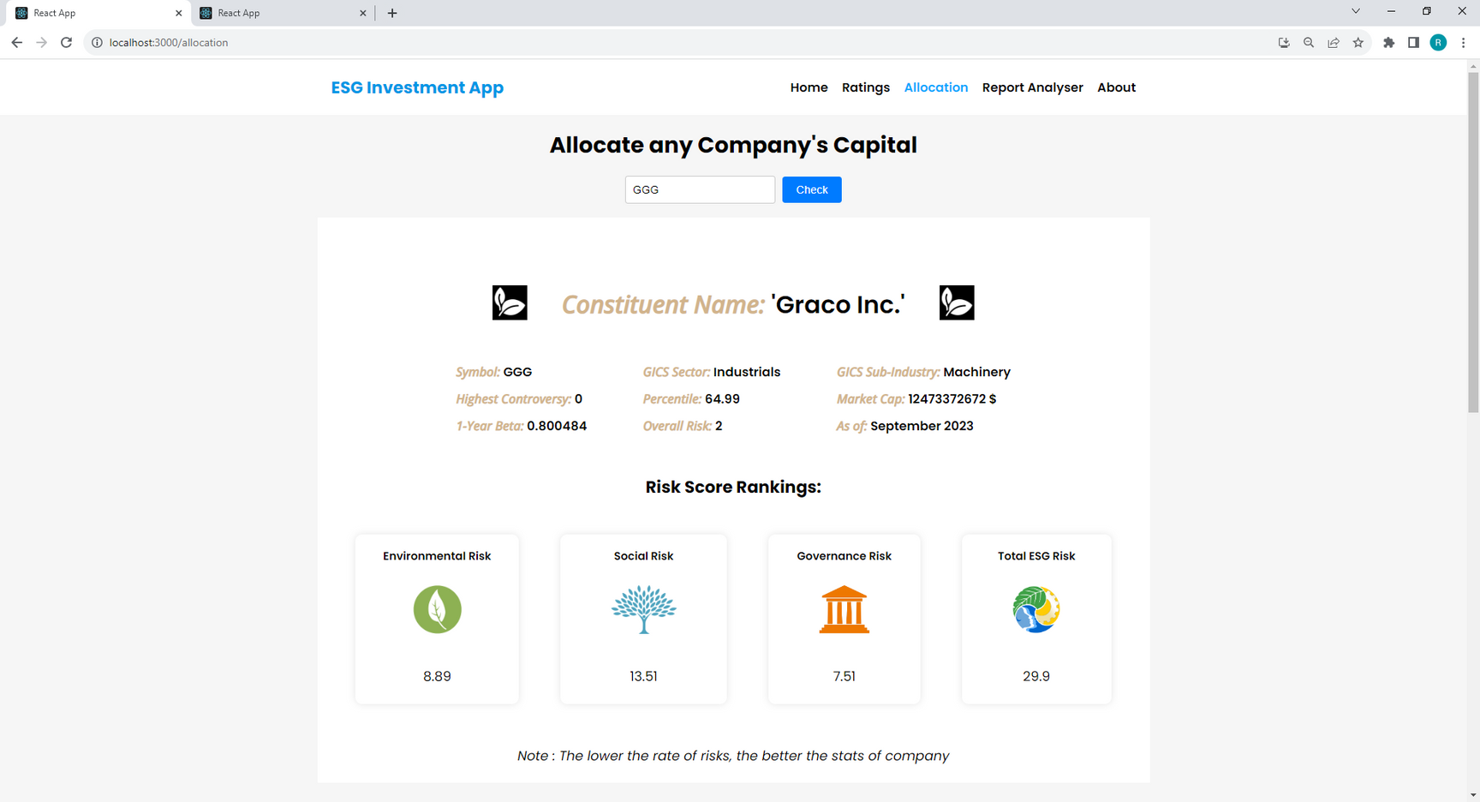
6
Allocation of company’s capital

Slide 24
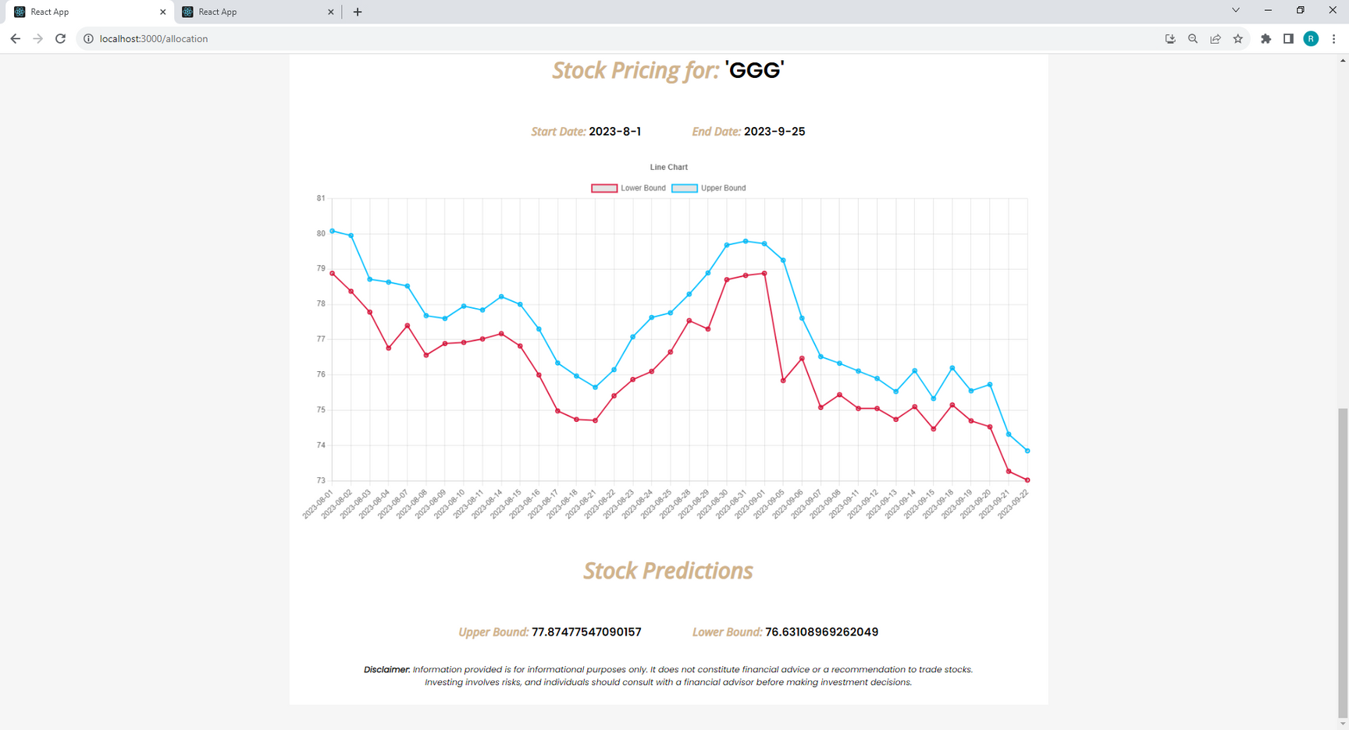
7
Analyzing stock pricing

Slide 25
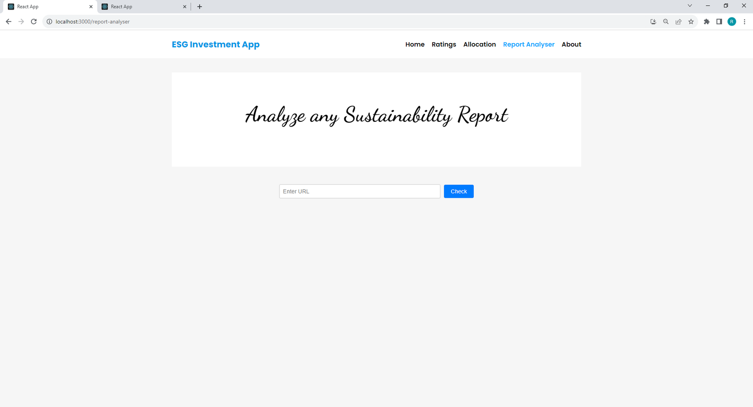
8
Report Analyzer

Slide 26
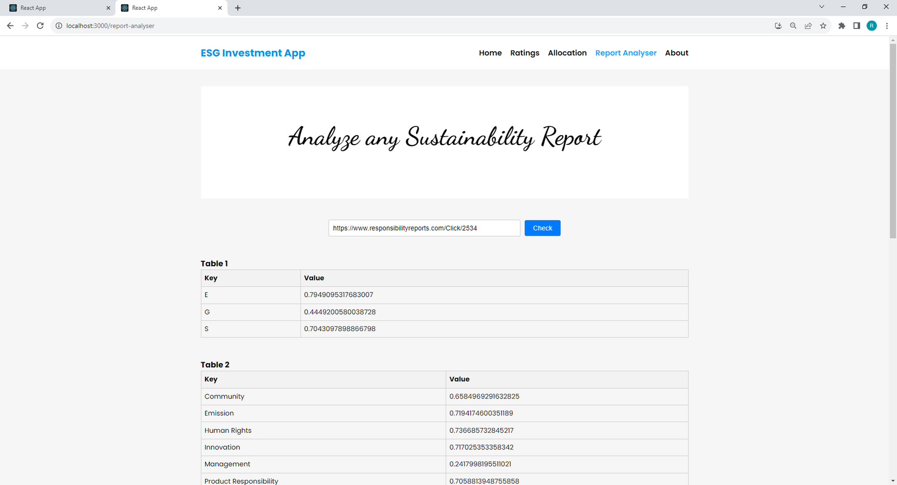
9
Analyze sustainability report

Slide 27
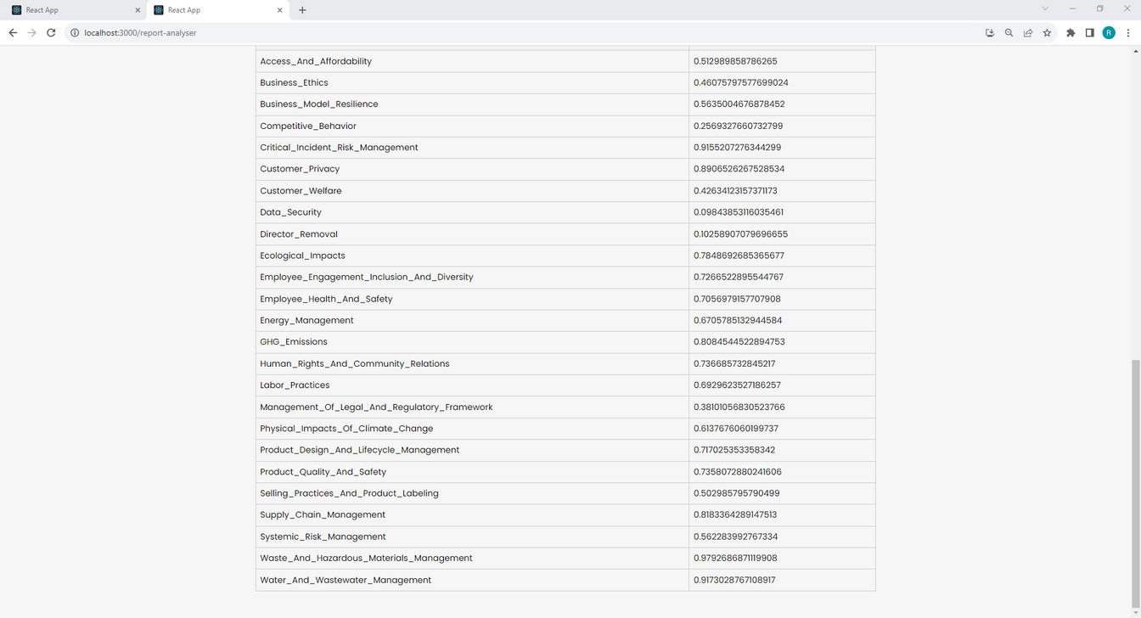
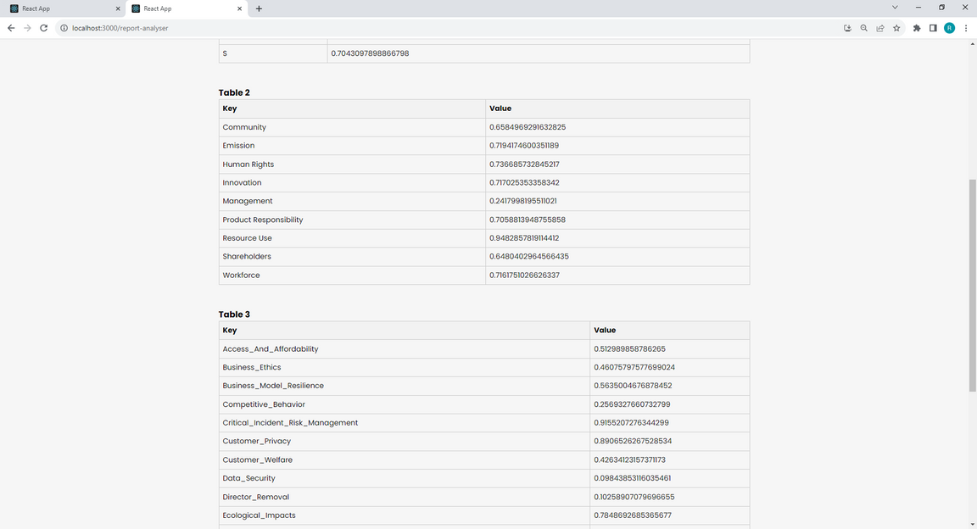
10
NLP Approach

Slide 28
CASE STUDIES
In one case study, NLP was used to analyze ESG reports of companies in the energy sector. The analysis revealed that companies with higher ESG scores tended to have better financial performance compared to those with lower ESG scores. This information helped investors make more informed decisions about which
companies to invest in.
In another case study, NLP was used to analyze ESG reports of companies in the technology sector. The analysis showed that companies with strong commitments to environmental sustainability tended to have higher employee satisfaction and retention rates. This information helped companies improve their reputation and attract top talent.

Slide 29










THANKING
YOU

